Slide 1

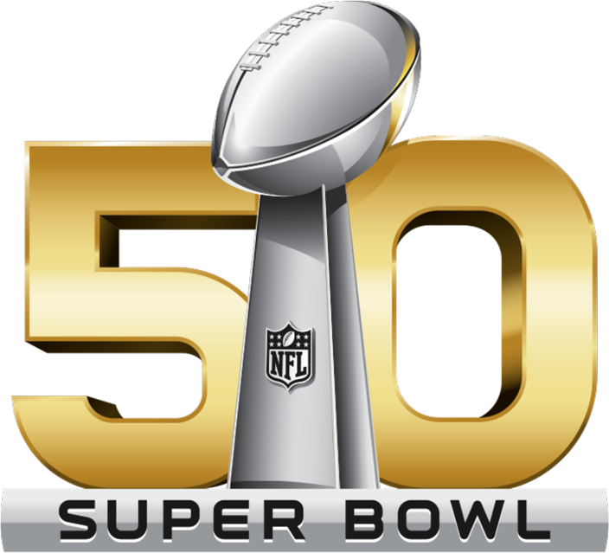
Twitter Analysis of Super Bowl 50
-- Dennis Silva
-- Xuanyu Li
-- Branden Diniz
-- Chuxin Wei

Slide 2
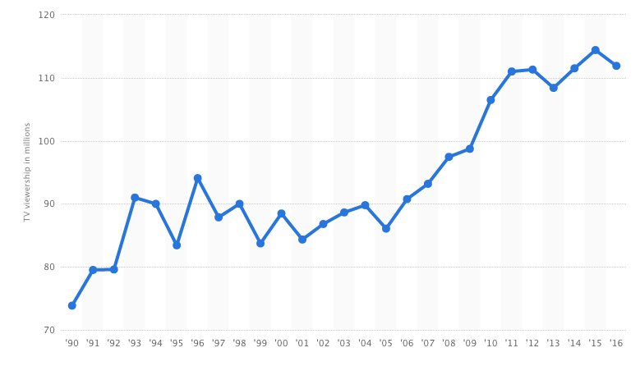
BACKGROUND
TV Viewership
TV Viewership of the Super Bowl in the United States from 1990 to 2016 (in millions)
Tweets in 2015: 28.4 million
(CNBC)
(Source: statista)

Slide 3
Methodology
Split our Data Collection into Two Sections
Streaming API
A specific advertisement
Real time results
REST API
A variety of advertisements
Increased number of tweets collected
Avoid rate limiting

Slide 4
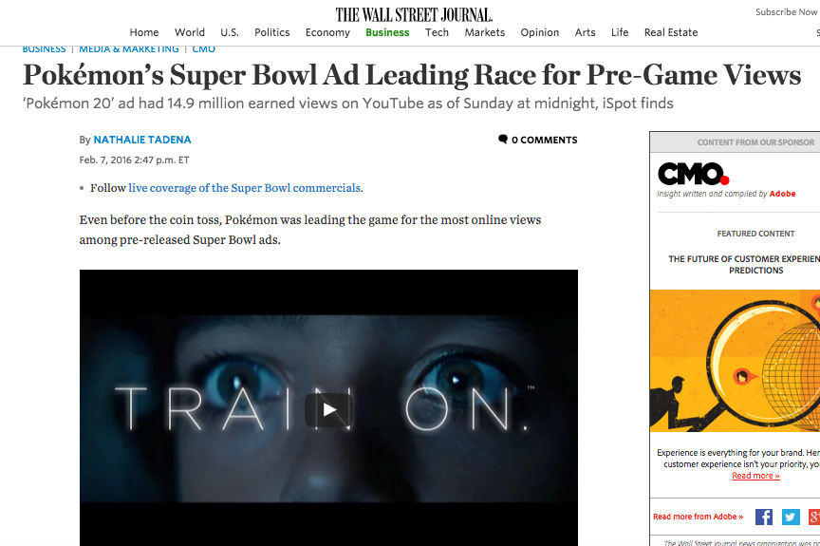
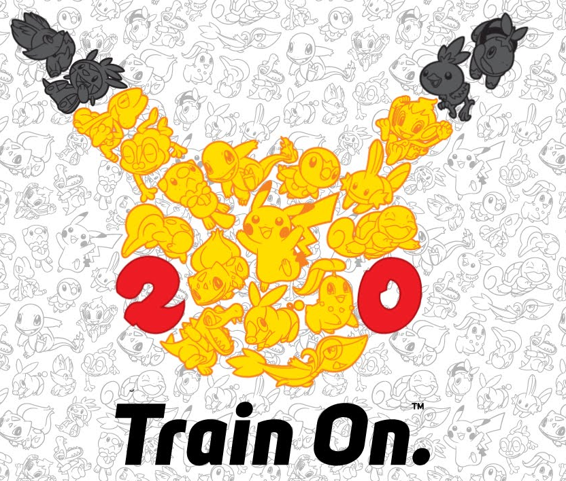
Methodology
https://www.youtube.com/watch?v=80Pl-fq6WPw

Slide 5
FINDINGS
1. Amount of Tweets
2. Frequency Analysis on Tweets
3. Frequency Analysis on Tweet Entities
4. Exploring Data: Commercials vs. Game

Slide 6
1&2. Amount of Tweets& Frequency Analysis on Tweets
Captured 13164 Tweets
Top 10 words
Top 10 Words | Count
super | 7837
bowl | 6874
Pokemon | 6014
#SB50 | 5429
@Pokemon | 4366
#Pokemon20 | 4322
commercial | 3930
ad | 2045
Spot | 1531
#TrainOn | 1077
Super Bowl & Pokemon
Commercial, Ad
Pokemon
Notes:
Frequency Analysis on Tweets:
Super Bowl and Pokemon are the most mentioned words. When talking about Super Bowl, many people will mention Pokemon or Pokemon20. The reasonable explanation for these two most mentioned words is that Pokemon will celebrate the 20th anniversary of the release of the original game by an ad during Super Bowl 50. Many people are very interested in it and are waiting for the release of the Pokemon’s Super Bowl commercial.
Commercial, Ad, and spot are the second most mentioned words when we search Super Bowl. In other words, people will always connect these words to Super Bowl. The reason why these three words are also mentioned frequently is because Super Bowl ad is one of the most important marketing campaigns launched before the game. Famous companies are fighting for the 30-second spot to increase brand awareness and advertise new products. In fact, the Super Bowl ads cannot affect sales much but they are part of pop culture. For audience, the TV commercials launched during the Super Bowl has turned into a social media integrated play, which are audience’s favorite.

Slide 7
2. Frequency Analysis on Tweets
The Top 10 Most Popular Tweets (Retweets)
Rank | Count | Text
1 | 23133 | RT @Pokemon: Get a first look at our #Pokemon20 Super Bowl spot and tell us how you plan to #TrainOn in 2016! https://t.co/aUIST5Hzob
2 | 1702 | RT @_Snape_: Did Lady Gaga just win the Super Bowl? #SB50
3 | 453 | RT @f_zamora3: Now we wait for the @Pokemon commercial during #SB50 https://t.co/odfYDfl0TV
4 | 362 | RT @Kate_Eglen: Pikachu cupcakes to celebrate Pokemon in the Super Bowl !! #Pokemon20 https://t.co/arNYvI3rL9
5 | 340 | RT @FunnyPokemon: Retweet if you're excited for the new Pokemon Super Bowl commercial! https://t.co/doyJSA4bf4
6 | 311 | RT @rudymancuso: If you drink, walk. Don't drive. #GiveADamn #SB50 @Budweiser #ad https://t.co/UCyYAlL6Fd
7 | 281 | RT @TheFakeESPN: Nothing says Super Bowl like Pokemon
8 | 222 | RT @EW: Celebrate 20 years of #Pokémon with this epic #SB50 commercial: https://t.co/g2tS0o8TKB https://t.co/jD0VEZCthY
9 | 205 | RT @USATODAY: Pokemon turns 20 this year: Watch anextended cut of the #SB50 commercial #admeter #pokemon20 https://t.co/kQHOAXcmJy
10 | 193 | RT @AshKetchum151: Who's waiting for the Pokemon commercial? #SB50
Notes:
The hottest tweet has 23133 counts. This tweet is about Pokemon’s Super Bowl commercial. The first, third, fourth, fifth, seventh, ninth, tenth most popular tweets are also about Pokemon. The content of these tweets show people’s willingness to watch the Pokemon Super Bowl commercial. A tweet with Pikachu cupcakes to celebrate the 20th anniversary of Pokemon is also very popular. The second hottest tweet is topic related to Lady Gaga and the sixth most popular tweet is about the commercial of Budweiser.

Slide 8
3.Frequency Analysis on Tweet Entities
Top 10 Hashtags Top 10 User Mentions
Hashtag | Count
SB50 | 5555
Pokemon20 | 4811
TrainOn | 1095
SuperBowl | 617
Pokemon20 | 409
Pokemon | 268
Pokémon | 214
admeter | 198
Pokémon20 | 176
collegelife | 174
User Mentions | Count
Pokemon | 4743
FunnyPokemon | 746
F_zamora3 | 417
Kate_eglen | 333
AshKetchum151 | 325
TheFakeESPN | 244
YouTube | 223
EW | 213
TheJWittz | 189
USATODAY | 183
Notes:
Change!!!

Slide 9
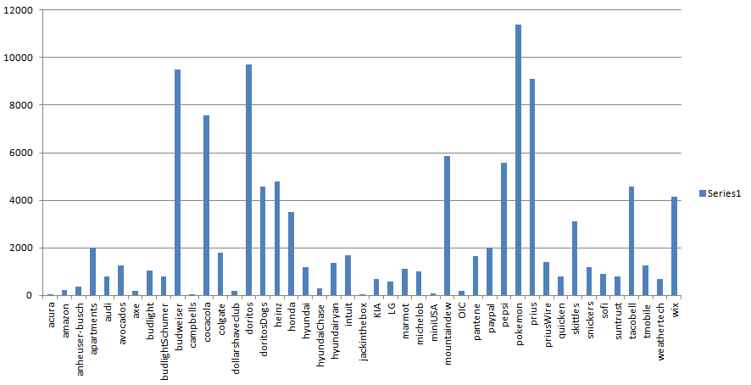
4. Exploring Data: Commercials vs. Game
Tweets about Commercials (111,021)
Commercial | Nintendo - Pokémon | Doritos - Ultrasound | Budweiser - #GiveADamn | Prius - The Longest Chase | Coca Cola - Coke Mini (Hulk vs. Ant-Man)
# of Tweets | 11397 | 9695 | 9492 | 9091 | 7588

Slide 10
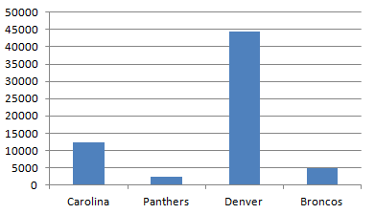
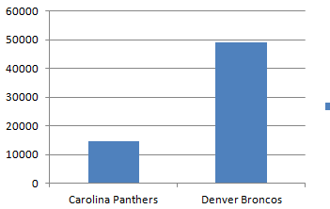
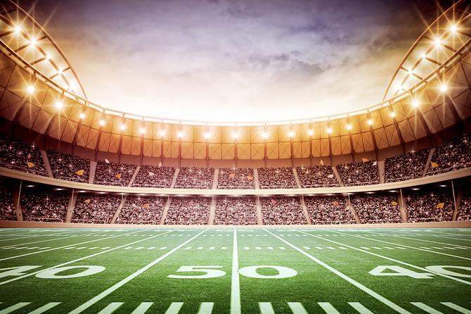
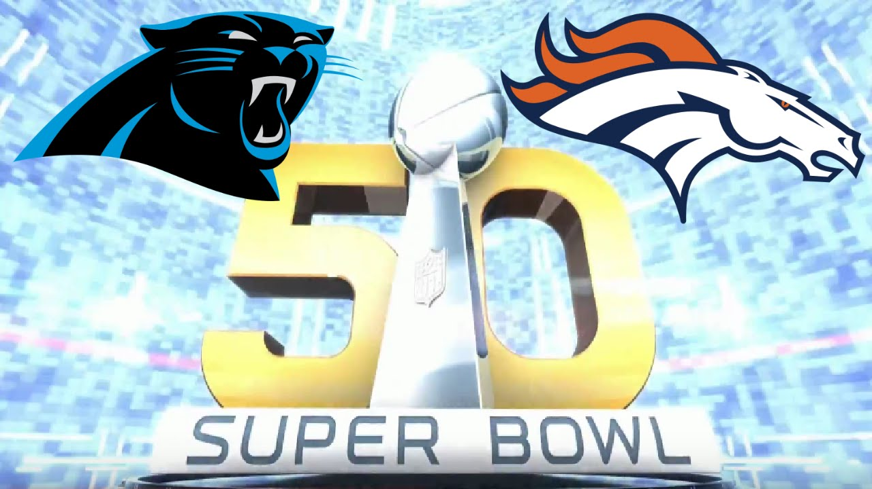
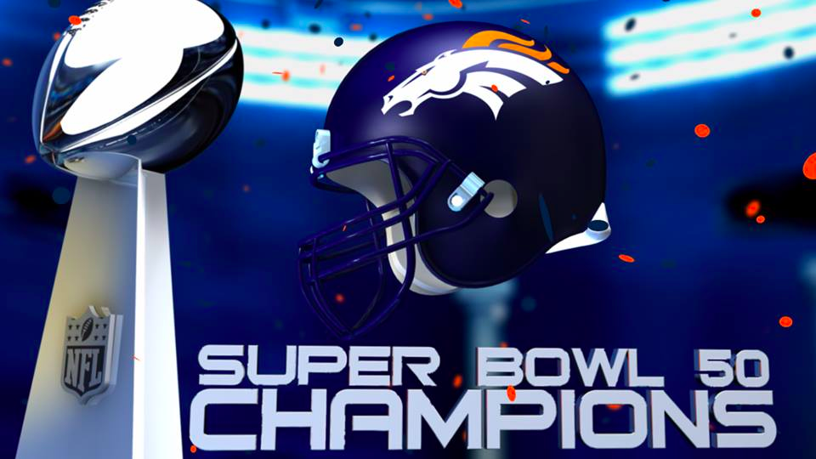
4. Exploring Data: Commercials vs. Game
Tweets about the Game (Broncos vs. Panthers )

Slide 11
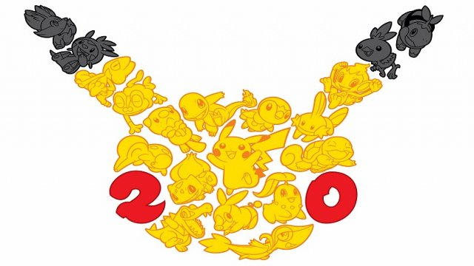
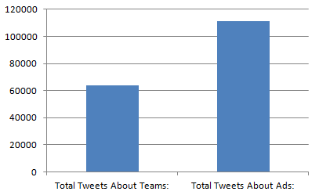
4. Exploring Data: Commercials vs. Game
Tweets: Commercials vs. Game

Slide 12
THANK YOU

